Slide 1



Workshop Day 2: SIMROUTE® Marine environmental module: methodology and calculation of Ship Emissions
Briefing
Chalmers University of Technology
April 6th, 2022

Slide 2
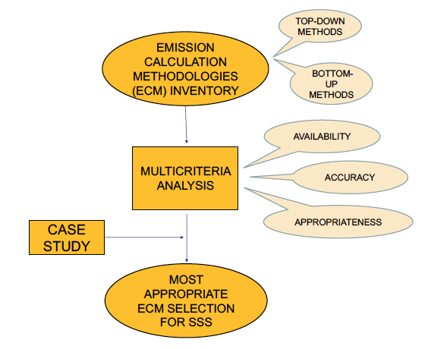
EMISSIONS MODULE
Scheme for research methodology
Notes:
THE FIRST STEP WAS to compare emissions calculation methods intothe context of Short Sea Shipping routes in terms of pollution mitigation.
An inventory of methods to calculate fuel consumption and/or CO2 emissions was elaborated applying them in aShort Sea Shipping route case.
Differences between of 16% and 52% were obtained in function of the emission factors and method selected.
Do you know what an emission factor is? an emission factor is a representative value that attempts to relate the quantity of a pollutant released to the atmosphere with an activity associated with the release of that pollutant.
The aforementioned method was found by assessing if the relevant parameters were already monitored/available on board and by analyzing the emissions calculation methodologies in terms of availability of data, accuracy and appropriateness of the method’s formulation to be translated into computational language.

Slide 3
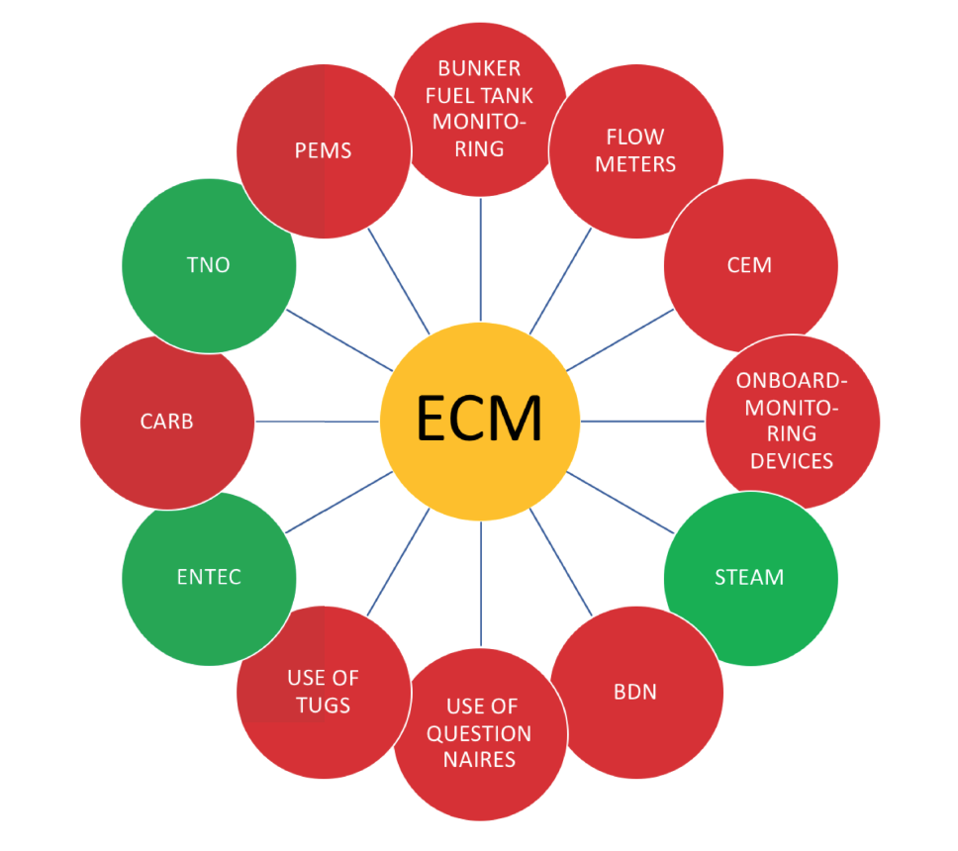
EMISSIONS MODULE
Emissions calculation methodologies inventory
Notes:
Twelve methodologies for assessing emissions were considered as a starting point, namely:
Bunker fuel tank monitoring;
Flow meters for applicable combustion processes;
Direct CO2 emissions measurements (CEM)
On-board monitoring Devices
Use of portable emissions measurement System (PEMS)
Bunker Fuel Delivery Note (BDN)
Use of questionnaires method
Use of tugs
Use of The California Air Resources Board (CARB) Method
Methodologies for estimating shipping emissions in the Netherlands (TNO)
ENTEC UK Limite
Ship Traffic Emissions Assessment Model (STEAM)
The six methodologies mentioned in first place are not taken into account in this research as they deliver direct emissions data or proxies but they are not modelling methods.
From the remaining methodologies, only bottom-up methodologies are taken into account because they consider vessels individually. Therefore, this leaves list of three methodologies

Slide 4
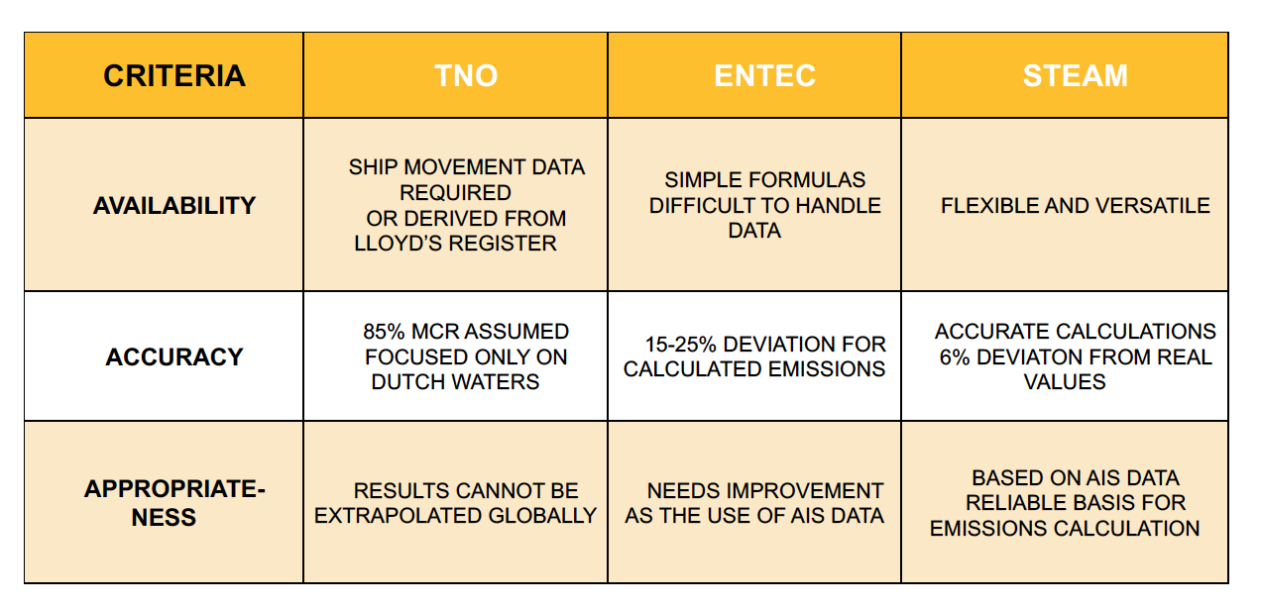
EMISSIONS MODULE
Multi-criteria analysis
Notes:
With the data gathered, each method was qualitatively assessed based on the following criteria:
- Availability and simplicity of assessment method: given by the applied model to calculate the emissions for a certain vessel and the availability of the input data to run the model.
- Accuracy: the accuracy of the data used in an emissions calculation methodology is vital for the integrity of the outcome.
- Appropriateness of the formulation of the method to be translated into computational language: the appropriateness is a subjective concept. The chosen method had to be easy to include into the Weather Ship Routing system and had to provide an outcome which represented a realistic value when compared to ship emission inventories from the European Union for the selected type of vessel.

Slide 5
EMISSIONS MODULE
Notes:
The methodology proposed is shown in Figure 1.
First, several initial parameters are required: (i) route characteristics (port of departure and port of arrival) and the period to study (day/month/year); (ii) vessel characteristics (length, deadweight (DWT), cruising speed) and (iii) the wave field for the sailing days, planned from EU Copernicus Marine Environmental Monitoring Service (CMEMS). Second, the minimum and optimal routes are obtained for the selected period.
Then, technical data from the IHS Markit Sea-Web database (engine power, design speed, lowest possible specific fuel oil consumption and the engine load) are used to estimate emissions. Finally, the percentage of fuel savings and emission mitigation are obtained.
Daily wave information is obtained from the Copernicus Marine Service (CMEMS). As the cases selected are routes in the Mediterranean Sea, the
MEDSEA product is used to provide wave information.

Slide 6






EMISSIONS MODULE
Notes:
However, when the vessel faces different sailing situations, this EL and SFOC will change if cruising speed has to be maintained. In order to assess emissions calculations, the power delivered by the engine has to be analysed in the different meteo-oceanographic conditions. For that purpose, an instantaneous power has to be defined for each of the intervals analysed over the route. Jalkanen et al. suggest a solution for assessing instantaneous
power, assuming that frictional, residual, appendage and air resistances are ship-specific constants. The formula for the instantaneous power (PInstant)
is expressed as shown as the selected methodology assumes that correlations describing frictional resistance, residual resistance, appendage resistance and air resistance, the propulsive coefficient and S the wet surface of the ship are typically functions of hull-specific parameters that cannot be found in available databases. A straightforward solution to this problem is to simplify the Transient power equation by assuming that CF, CR,
CA, CAA, S and $ε_{0}$ are ship-specific constants. Then the instantaneous power can in that case be written simply
In general, the aforementioned power P is the power output at Normal Service Rating (NSR), PNSR, which is the power needed to sail at cruising speed. This NSR is usually lower than the Maximum Continuous Rating (MCR), defined as the maximum output power for the engine running under safe condition in a continuous manner (PMCR) to maintain design speed. The relation between the MCR and the installed power (PInstalled) is defined as Engine Load (EL). The engine manufacturer will state the EL for running the engine at the most efficient condition as well as the specific fuel oil consumption of the engine (SFOC) under such conditions
SIMROUTE provides a grid-based itinerary, the node-to-node being defined as an interval (i) and a correspondent sailing time (Dt). In consequence, the average instantaneous power per time interval, in terms of the vessel’s instantaneous speed (vInstant), was estimated assuming that the power varies as v3.

Slide 7
EMISSIONS MODULE

Slide 8
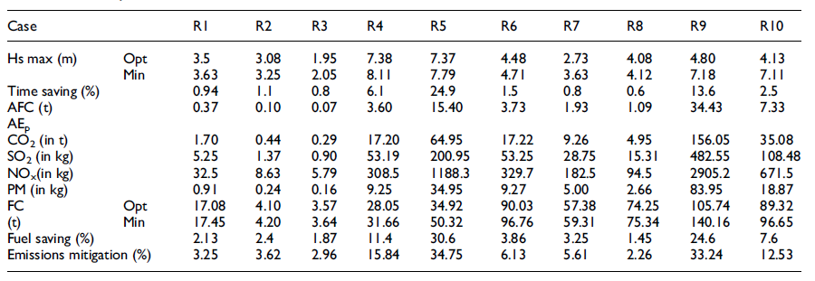
EMISSIONS MODULE

